Slide 1
Babylon Junior-Senior High School PSAT/SAT/ACT Workshop
Kevin Dennis
Director of Long Island Classes
Method Test Prep

Slide 2
What is MTP Made Of ?
Passion
Every student should have access to high-level prep
Knowledge
We take the tests ourselves
Experience
SAT & ACT experts for 17 years and counting

Slide 3
Part I Understanding Your PSAT Report

Slide 4
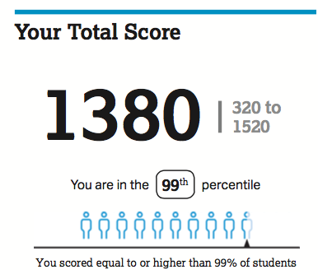
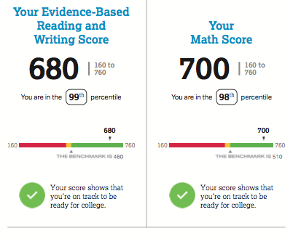
The Big-Picture Scores
The total score is 1520? How does this align with an SAT score?
Keep in mind that the PSAT is slightly shorter & easier
“Vertical scoring scale” means you can equate PSAT & SAT
Colors indicate performance –– notice benchmarks

Slide 5
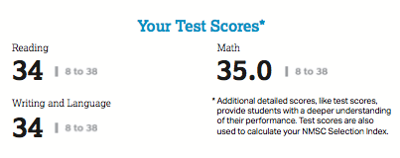
Where Did the Scores Come From?
Think of these as preliminary scores that are then scaled
The Reading and Writing & Language scores contribute equally to the Evidence-Based Reading & Writing Score
The Math score came from the No-Calculator and Calculator-based sections

Slide 6
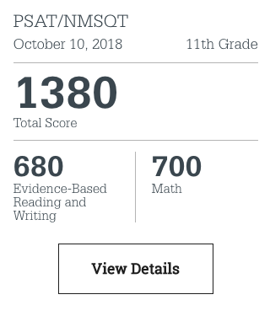
More Numbers Online
Log on to psat.org/myscore
Click “View Details”

Slide 7
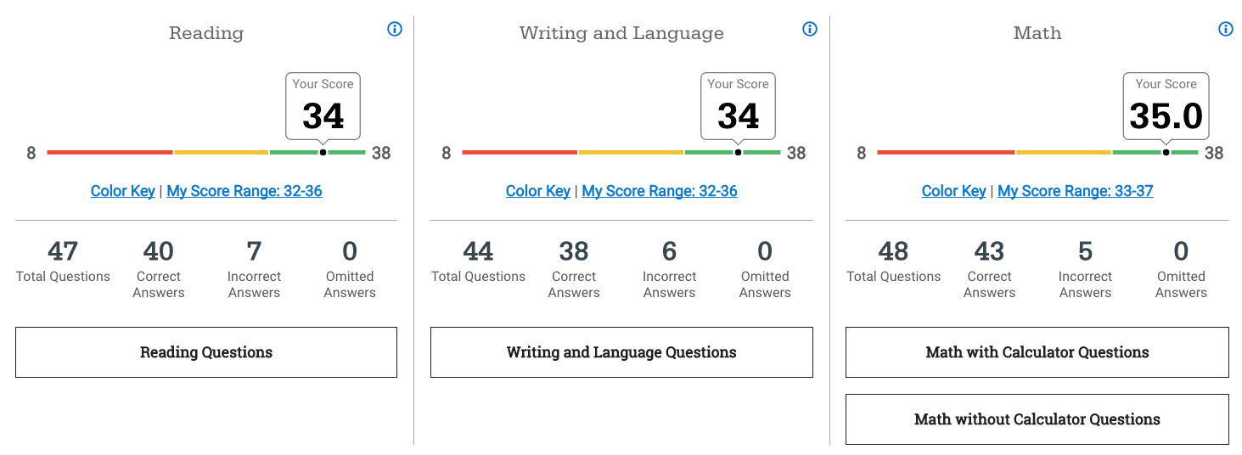
More Numbers Online
These are visual representations of the individual section scores, with benchmarks
View # of correct, incorrect, and omitted answers
Click question boxes below to see actual questions, your answers, and correct answers (Wednesday, Oct 10 administration only)

Slide 8
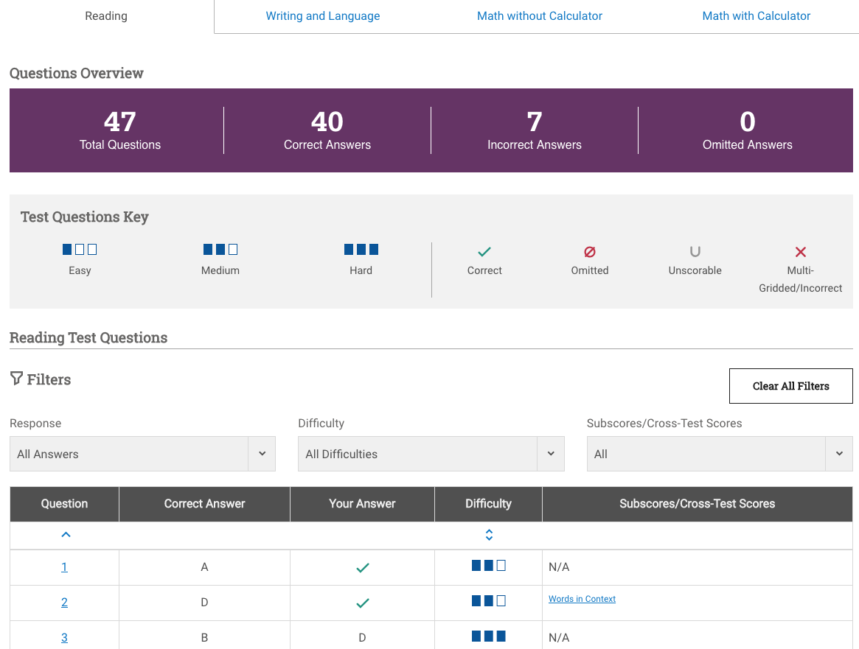
Question-Specific Breakdown
Section tabs
Access by clicking Question boxes below section scores
Click question numbers to view questions and answers (Wednesday PSAT only)

Slide 9
The NMSQT Index
Ranges from 48 to 228
Used to gauge whether you are in contention for National Merit Scholarship
Commendation
Semi-Finalist
Finalist
Scholarship status is announced in fall of senior year (only juniors are eligible); qualifying scores for levels of recognition vary by state and year

Slide 10
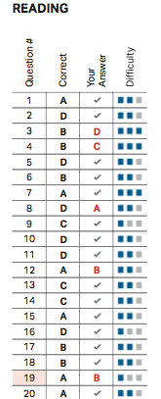
Taking Advantage of Your Report
Review the problems you answered incorrectly (red letters)!
Numbers shaded in light red are “easy” level questions––pursue this low-hanging fruit first!

Slide 11
Part II
The SAT

Slide 12
SAT – Reading
Content Areas
No sentence completions!
Reading comprehension (passages & questions)
Integrated graphics & data interpretation questions
Evidence questions
Vocab in context
Structure & Scoring
1 section
65 min (60 min PSAT)
Score range 10-40 (will combine with Writing & Language to create a score from 200-800)

Slide 13
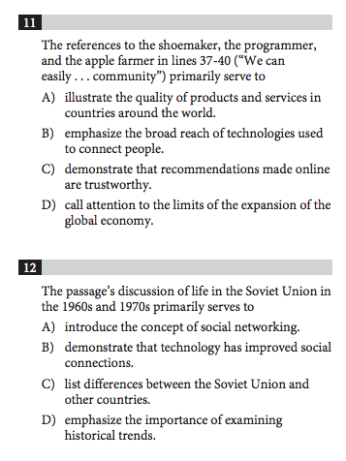
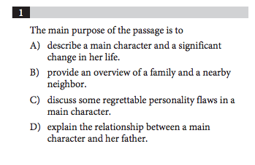
Question Type – Main Idea
Use key phrases
“Main purpose”; “Main idea”; “Primarily serves to”
Bottom line: “What’s the point?”
Flaw in student approach: letting the answers drive the thought process
Instead, go back, read reference lines, try to derive your own idea before looking at choices; then align own answer to choices
Answers always contain distractors that seem relevant, but don’t actually answer question

Slide 14
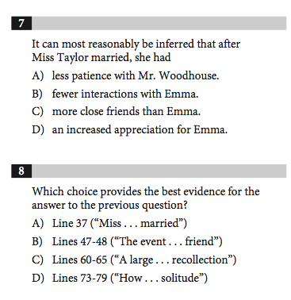
Question Type – Evidence
New to the SAT
Always used as a follow-up question
Potential for “double-whammy” incorrect answer pattern
Many of the answers to the evidence question will be relevant to the idea in question: only one will support the idea specifically
Great technique: anticipate the best evidence yourself; if you don’t see it there, your first answer may be incorrect!

Slide 15
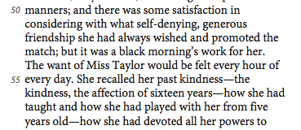
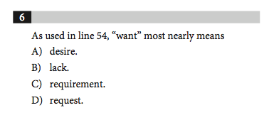
Question Type – Words in Context
Will now focus on simple, common words that can take on many different meanings
Common flaws in student approach: (1) assuming a word is used as it “always” is, (2) not reading far enough around or considering local & global main idea
Here, student could use phrases around the word (she “recalled” her past kindness) and use main idea of passage (that Emma & Miss Taylor had been separated)
More frequent – will now constitute about 20% of Reading test questions

Slide 16
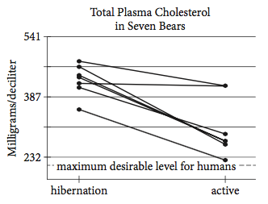
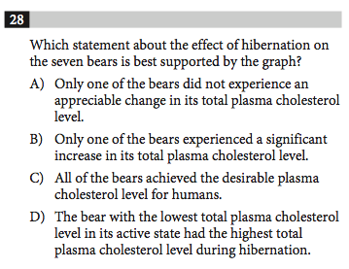
Question Type – Data Integration
New to SAT
Will pair a relevant graph, table, or chart with the passage
Students will have to integrate terms and references in the passage with visual information to reach a conclusion
Common student errors: careless reading of axes; incorrect “extension” of an idea to incorporate unsubstantiated claim
Will constitute about 5% of Reading test questions

Slide 17
SAT – Writing & Language
Content Areas
Improving sentences
Finding errors
Improving passages
Structure, punctuation, rhetorical skills
All passage-based
Graphics integration
Structure & Scoring
1 section
35 min
Score range 10-40 (will combine with Reading to create a score from 200-800)
A near clone of the ACT English section

Slide 18
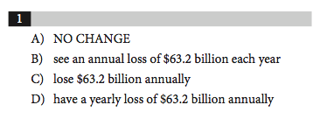
Just Like One Big “Improving Paragraphs” Section

Slide 19
An Example: “Red Flag” Words
Where’s the error?
The congressional panel issued their findings after conducting an investigation that lasted for over a year.
The congressional panel issued their findings
The congressional panel issued its findings

Slide 20
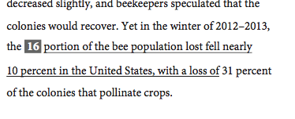
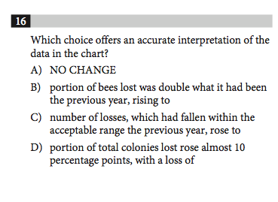
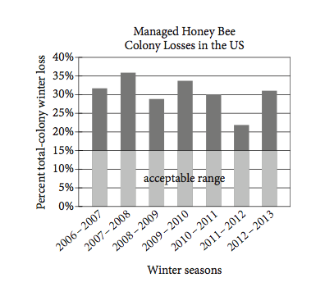
Plus Data
Will also integrate data, whose interpretation can alter the sentence

Slide 21
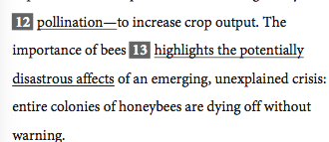
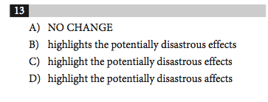
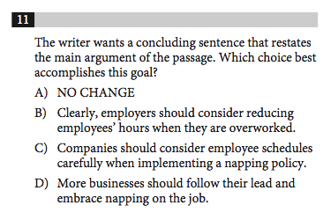
Writing & Language Pitfalls
#1 most common mistake: not reading enough around the underlined portion
Get fuller context
Re-read the sentence in full with your choice before moving on
For rhetorical (placement, relevance, etc.) errors, students may have to read several sentences or may even have to re-read paragraphs
Not understanding the subject
Distinguish “red flag words” using MTP’s program
Pronouns
Conjugations of “to be”
Highlight prepositional phrases
Not actually giving the question “what it wants”
Don’t simply pick what “sounds good”

Slide 22
SAT – Math
Content Areas
Algebra (emphasis here)
Geometry (much less)
Algebra II (more of it)
Data & statistics (more of it)
Trigonometry (a little)
Extended thinking
Multiple choice & grid-in
Structure & Scoring
2 sections
No-Calculator – 25 min (20 PSAT)
Calculator – 55 min (45 PSAT)
Score range: 200-800

Slide 23
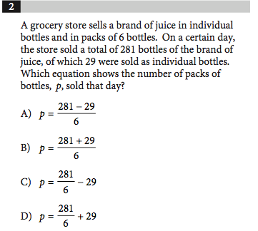
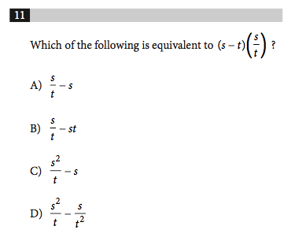
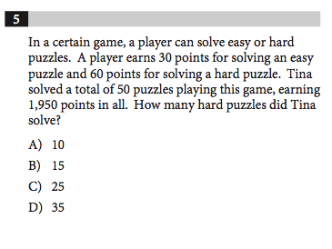
Algebra to the Max
MAJOR emphasis on
Constructing algebraic expressions based on statements
Algebraic manipulation
Factoring
Solving in terms of multiple variables
Solving multivariable equations
Systems
“Break-even” and “Two-Variable” problems
Basic algebraic skills are often weak
From No-Calculator section – guess & check method would be too burdensome for most

Slide 24
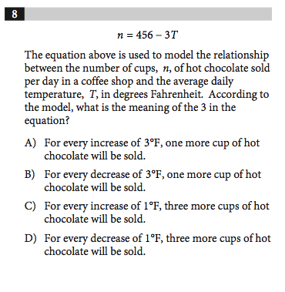
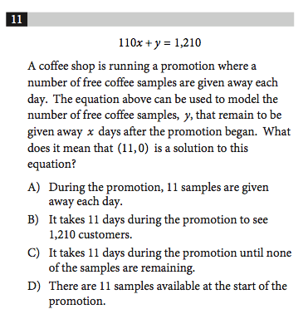
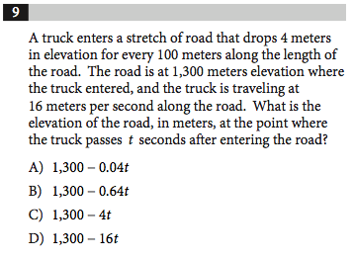
Understanding Linear Relationships
MAJOR emphasis on
Interpreting slope & y-intercept terms in context
As opposed to simply “find the slope/find the y-intercept”
Constructing linear equations based on relationships
As opposed to just “plug & chug”
Interpreting models in real-world contexts

Slide 25
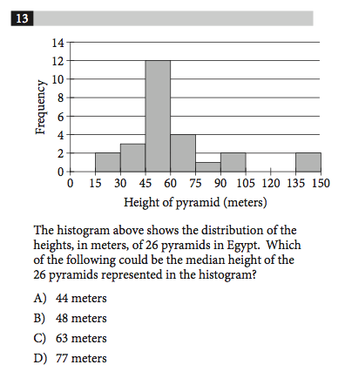
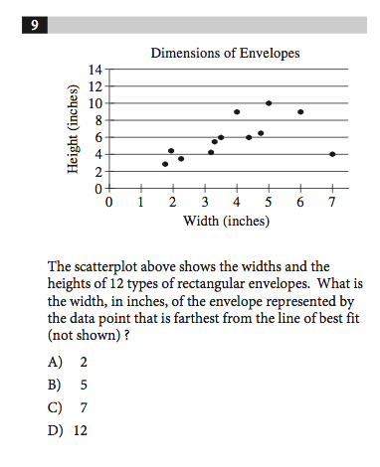
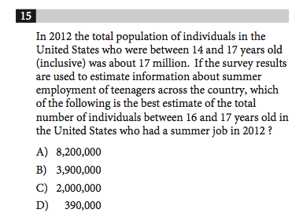
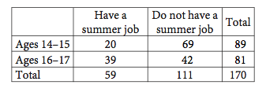
Basic and Intermediate Statistics Interpretation
MAJOR emphasis on
Graph reading & information gathering from charts
Understanding line of best fit

Slide 26
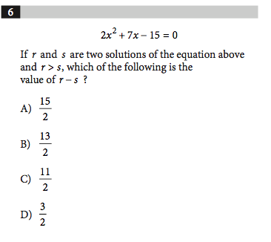
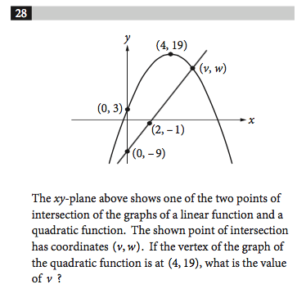
Quadratics
Significant Emphasis on Quadratics
Understanding algebraic and graphical relationship between standard form, factors, and roots
Graphs of polynomial functions
Will be mostly more difficult questions

Slide 27
Mathematics Suggestions
Redouble efforts to bolster your basic and intermediate algebra skills
“Algebraic gymnastics”
You should be comfortable reading two-way tables and graphical figures
Emphasize proportional reasoning
Will be useful for linear relationships and converting
Know your mean, median, and standard deviation
E.g., how manipulating the data can or can’t change the mean; working with weighted averages; frequency histograms

Slide 28
SAT – Evidence-Based Writing
Formulate arguments based on a provided document
No more “making things up”
Essay Structure & Scoring
50 min
3 sub-scores graded on 0-8 scale
Suggestion: consider elements of persuasion prior to test
Language choice, rhetorical style, irony, sarcasm, appeal to emotion, logic, etc.

Slide 29
Part III
The ACT

Slide 30
ACT Overview
English Math Reading Science
75 questions
45 minutes
60 questions
60 minutes
40 questions
35 minutes
40 questions
35 minutes
Questions more straightforward
English is the same as SAT Writing & Language section
Pace is a huge factor
Science isn’t really “science” – it’s glorified reading comprehension with charts and graphs
All section scores out of 36; averaged for composite out of 36
Optional Essay at end of test – 40 min, response integrating perspectives; graded out of 36, but does not affect the composite score

Slide 31
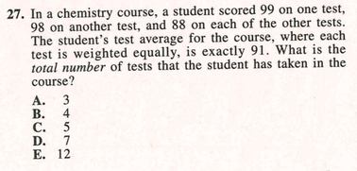
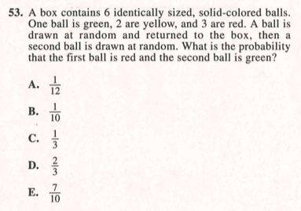
Math – Some More Stats and Probability
There has been a slight increase in the proportion of basic statistics and probability questions
Mean, median, mode, range, basic probability of events
Greater emphasis on “STEM”-related problems more likely to be encountered in college
Still a majority emphasis on algebra I and II and geometry
Questions more straightforward than SAT math questions

Slide 32
Reading – Paired Passages
Reading test features 4 passages with 10 questions each, to be completed in 35 min
One of the four passages now is “paired”
Questions apply to one or the other passage, or both
Hasn’t significantly increased difficulty – aligns with SAT Reading
Questions concern main idea, vocab in context, inference, details

Slide 33
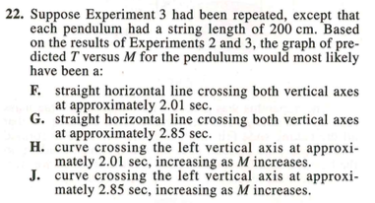
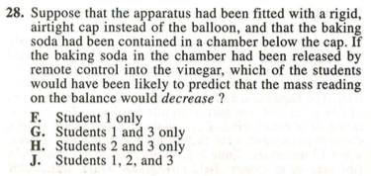
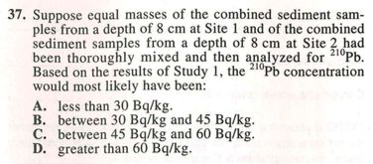
Science
Six passages to be completed in 35 minutes.
Passages contain between 5 and 7 questions.
Primarily reading comprehension of charts, graphs, and text.
The science can be anything (i.e. Biology, Chemistry, Environmental Science, etc.) but a student does not need to have taken the class.
Greater prevalence of “experimental procedure” questions, but overall, there is lots of graph and chart interpretation

Slide 34
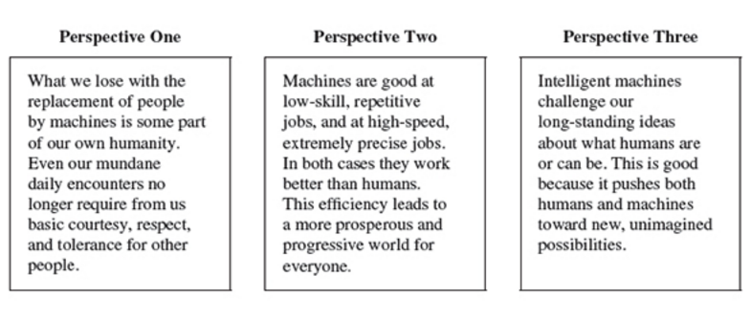
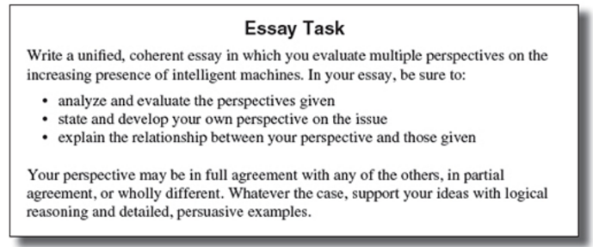
ACT – Essay
The “New” ACT Essay is not that much different from the old one – 40 minutes now
Pick a side (just like the old one), but address each of the positions as it aligns with/conflicts with your position
Now on 1–36 scale

Slide 35
Part IV
A Logical Prep Timeline
and
How to Prepare

Slide 36
A Smart Timeline for Prep
SAT
ACT
Juniors: Start prepping now
Shoot for March or May exam
Sophomores: Start prepping this summer
Shoot for August or October exam
Seven exams throughout the year
Question-Answer Service (QAS)
March
May
October
Juniors: Start prepping now
Shoot for April or June exam
Sophomores: Start prepping this summer
Shoot for September exam
Seven exams throughout the year (July not offered in NY)
Test Information Release (TIR)
December
April
June

Slide 37
Prep Suggestions
Practice early and often by taking timed sections
Take full-length practice tests
Find a comprehensive prep resource
Know that just a few questions can make a huge difference

Slide 38
MTP Online
Complete SAT and ACT courses
Lessons, quizzes, audio/video explanations, vocab builder
Go at your own pace, access from anywhere with internet

Slide 39
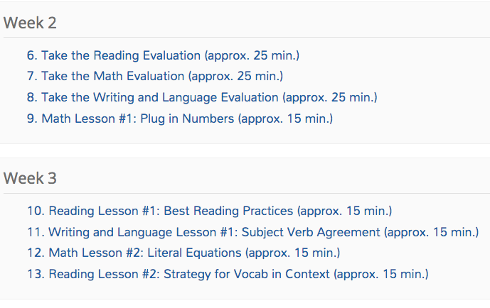
A Structured Checklist of Tasks

Slide 40
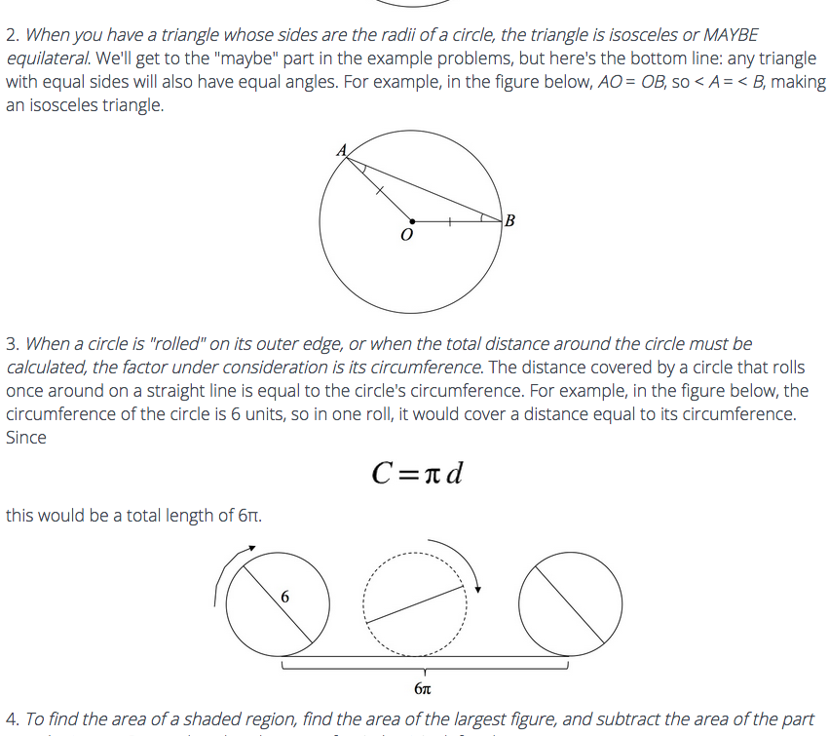
Rich, Engaging Lessons

Slide 41
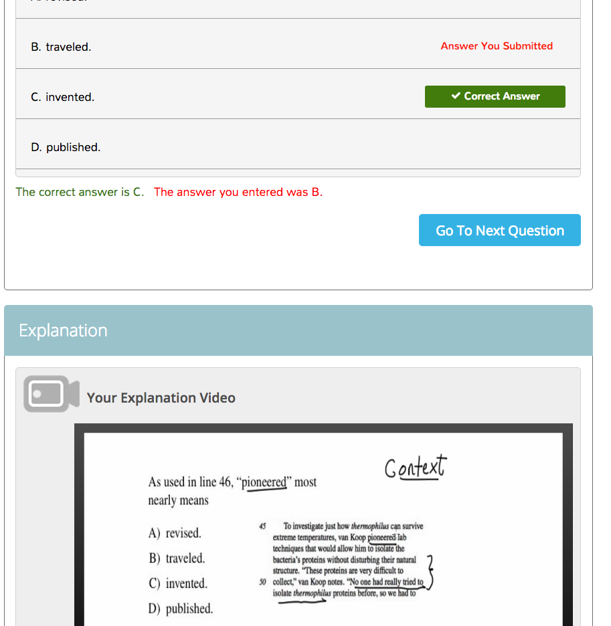
Instant-Feedback Quizzes

Slide 42
Even More Features!
Full-length exams
Concept summary reports – highlight strengths and weaknesses
Quiz on-demand
Vocabulary Builder

Slide 43
What Else from MTP?
Completely interactive web-based courses and tutoring
SAT & ACT “Miniseries” provides focus the week before tests
Incredible support

Slide 45
Thanks for Listening!
Questions?
kdennis@methodtestprep.com
516-597-4997

